Slide 1


Crystallum Orbis
Always Ahead
Presented by Electrifiers_3001

Slide 2
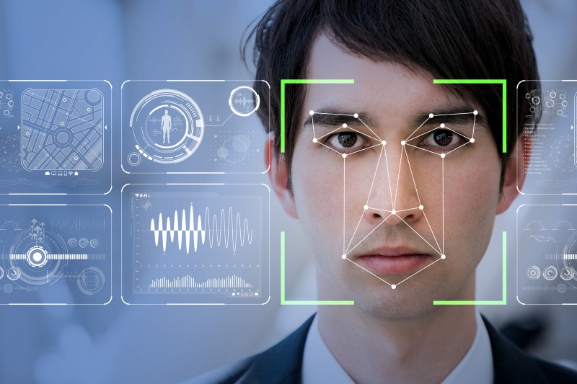
FACE RECOGNITION SYSYTEM FOR CRIMINAL DETECTION

Slide 3
Problem Statement:
The security of India is becoming ever more critical in this new world. There is an expectation of a slew of organized crime activities that may attempt to cripple our law enforcement and defense agencies. In such a scenario, technology becomes of paramount importance.
One aspect of the use of technology in law enforcement is video analytics, and video analytics has various components. One of the components is to identify patterns across different videos.

Slide 4
Solution Proposed:
To develop an accurate face recognition analytics system that would assure maximum accuracy and traits at the time of a criminal trial and can be integrated with CCTV cameras in order to identify and differentiate criminals from the live feed of crowd, we propose the use of following methodologies, which will be discussed in length later:
HOG (Histogram of Oriented Gradients) feature descriptor
SSIM (Structural Similarity Index Measure) technique
Image Data Generator
Inception_Resnet_V2 model for training of the dataset generated
These are technology/models used.

Slide 5
HOG Feature Descriptor
A HOG feature descriptor is computed by calculating image gradients that capture contour and silhouette information of grayscale images.
Gradient information is pooled into a 1-D histogram of orientations, thereby transforming a 2-D image into a much smaller 1-D vector that forms the input for machine learning algorithms such as random forests, support vector machines, or logistic regression classifiers.
We are employing the use of HOG feature descriptor to detect the faces and extract them in a folder for dataset formation.

Slide 6
SSIM (Structural Similarity Index Measure):
SSIM is used for measuring the similarity between two images. The measurement or prediction of image quality is based on an initial uncompressed or distortion-free image as reference. SSIM is designed to improve on traditional methods such as peak signal-to-noise ratio (PSNR) and mean squared error (MSE).
The difference is that previous approaches estimate absolute errors; on the other hand, SSIM is a perception-based model that considers image degradation as perceived change in structural information.
We are employing the use of SSIM Technique to create directories for different criminals by comparing all the images in dataset and clustering similar images.

Slide 7
ImageDataGenerator
To build a powerful image classifier using very little training data, image augmentation is usually required to boost the performance of deep networks.
Image Augmentation artificially creates training images through different ways of processing or combination of multiple processing, such as random rotation, shifts, shear and flips, etc.
An augmented image generator can be easily created using ImageDataGenerator API in Keras.
It generates batches of image data with real-time data augmentation.
We are employing the use of ImageDataGenerator to increase the dataset images of criminals with less images.

Slide 8
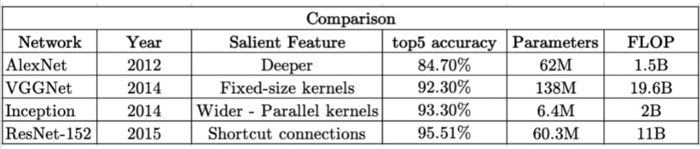
Inception-ResnNet-v2
Inception-ResNet-v2 is a convolutional neural network that is trained on 55873736 parameters, on more than a million images from the ImageNet database.
The network is 164 layers deep, as a result, the network has learned rich feature representations for a wide range of images. The network has an image input size of 299-by-299.
We are employing the use of Inception-ResNet-v2 Pre-Trained Model to train the dataset images extracted by the HOG feature descriptor and clustered by SSIM technique.
Why Inception? Not VGG or AlexNet

Slide 9
Methodology:
Step-wise explanation of the methods used by us for solving the problem statement:
Using HOG feature descriptor to detect the all the faces in the training video and extract them to a dataset folder for further training purpose.
Making directories for each face detected and accumulating similar faces in the same folder using SSIM Technique. Thus, we get a training images dataset for each face detected.
In order to make sure that training dataset is sufficient for each directory, we used ImageDataGenerator API so as to prevent overfit or underfit of training data.
We trained the dataset extracted by HOG using Inception_Resnet_V2 training model which is 164 layers deep and got an accuracy of 92.37% on training data.
Finally, we can import the trained model for any other video or live CCTV feed for prediction of criminals in it.

Slide 10
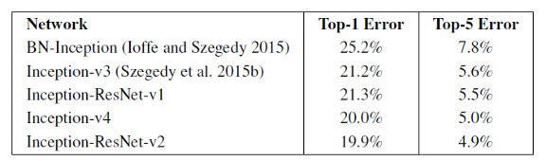
Innovations in the Proposed Solution:
Use of HOG Feature descriptor over other descriptors like SURF and SIFT, since it operates on local cells, it is invariant to geometric and photometric transformations, except for object orientation. The HOG descriptor is thus particularly suited for human detection in images.
Use of Inception_Resnet_V2 since with Single-Crop Single-Model, Inception-v4 and Inception-Resnet-v2 have the best performance with similar results as is evident from the image below:

Slide 11
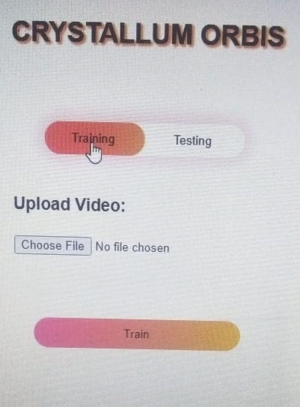
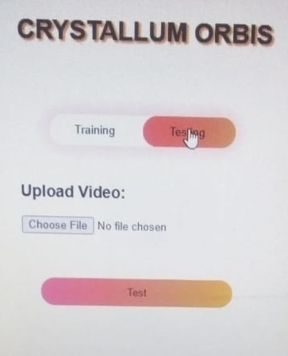
Notable Features:
We are making separate directories for each criminal in training dataset, so that each criminal can be recognized individually.
Each image in the prediction is stamped with the time when the face appeared in the testing video, so we can know the time when a person appeared at a place.
Future Aspects:
Integration of MySQL database for storing database.
Deploying the trained model on a web-based application for real-time criminal detection. On right side is the prototype of a web-based application we tried to integrate with our trained model:

Slide 12
THANK YOU

